Slide 1
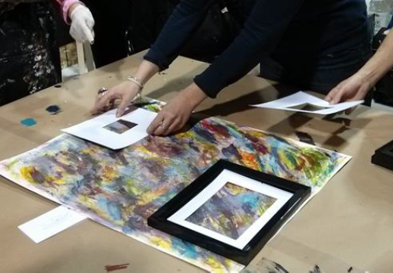
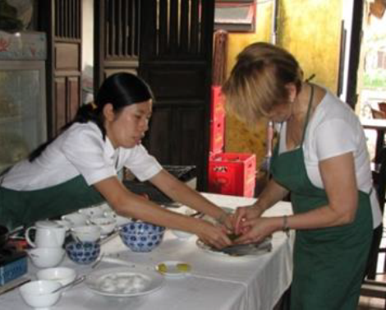
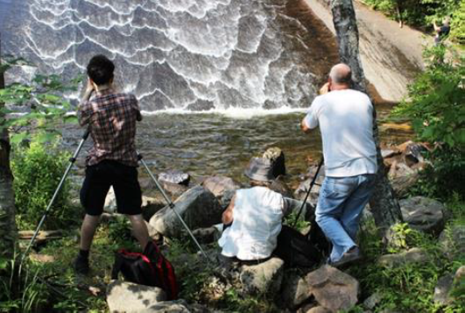
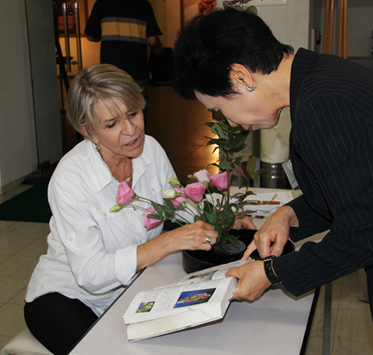
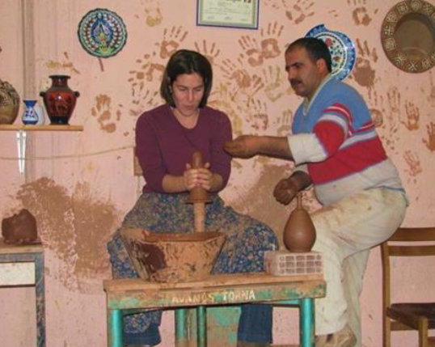
.
CREATIVE TOURISM, an Introduction
GISU International Webinar - October 28, 2021
Notes:
So pleased to represent UQAM on the subject of creative tourism, which happens to be the subject of my doctoral thesis. Thank you everyone for attending this quite extraordinary webinar! Now let’s start right now!

Slide 2
CREATIVE TOURISM
An initial definition
A dialogue, a conversation, a relational connection
‘An escape route from the serial reproduction of mass cultural tourism’ (Richards, 2011)
An interactive dimension to discover local cultures
Definition modulated by place identity and culture
Tourism which offers visitors the opportunity to develop their creative skills and potential through active participation in creative experiences which are characteristic of the place where they are offered.
(Richards et Raymond, 2000; Duxbury & Richards, 2019)

Slide 3
Creative Tourism - Main features
Active participation from the visitors to immerse themselves in the local culture by learning about the place they visit, with creativity as an activity (Richard, 2011)
Active learning experiences: deeper understanding, ‘acquisition of knowledge and skills’ (De Bruin & Jelincic, 2016)
Creativity based : developing new models of encounters, stimulating innovation and creative self-expression (Bakas et al, 2021)
Cocreation of experiences with the artists, the community and the visitors – a shared value creation (Dias et al, 2018)

Slide 4
Relevant aspects
Creativity, a limitless and renewable source
Little infrastructure needed
Soft impact
Strengthening of community identity linked to place distinctiveness
Bottom-up approach
Regenerative relationship between hosts and guests
Niche market for culturally motivated travellers
Research projects such as CREATOUR to support communities

Slide 5
What are visitors looking for ?
Experiencing the local culture while understanding the history, place, habits, lifestyle, food and community events, exhibits, performances
Authentic, meaningful interactions ; social connection
Self-searching; transformational
Control over trip planning and personalisation thanks to digital access to information
Connecting with technology and smart cities: augmented reality, promotional and marketing access via social media, facilitating access to local activities
Culturally motivated; sustainably and socially conscious travelers: a social turn
In stride with ‘Living like a local’ trend: a threat or a benefit to the community?

Slide 6
Types of creative experiences
Learning activities and demonstrations: reproducing or getting acquainted with the cultural creative aspects of a place, many related to craft
Creative workshops: being inspired by the artist, by the artisan for the visitors to use their own creativity and skills, an opportunity to self-expression
Interacting: learning and interacting on the the spirit of a place
Combining creative activities involving nature, history, landscape, daily life, food, music, and other arts such as photography, writing, filiming, designing, digital art, etc.
Place distinctiveness related, depending on parts of the world, countries, region, and cities / prevents being copied or imported!

Slide 7
Creative tourism: an evolution
Once, a new outlook about intangible culture vs tangible culture
Then, a cultural turn: finding a new way to interact with visitors, a merge between creativity and tourism via workshops and experiences
Next, the idea of cocreation of experiences based on the creativity of a its artists, its community and its place, alongside with the visitors contribution
Emerging trends: place making, community involvement, relational experiences
But potential pitfalls such as creative washing, serial reproduction, visitor animation (artists as inspirers, not as entertainers)
Bottom line: need for sustainable benefits for the artists and their communities, a social turn
Notes:
From my 5-year analysis

Slide 8
The CREATOUR Project
A 44-month research-and-application project (2016-2020) based on research activities, field work and IdeaLabs, 40 pilot initiatives, networking and clustering, annual conferences, webinars and publications
An overall objective to develop and pilot an integrated approach and research agenda for creative tourism in Portuguese small cities and rural areas.
Key dimensions: build knowledge and capacity, support content development and link creativity to place; strengthen network and cluster formation https://creatour.pt/en/about/overview/
A prize-winning documentary: CREATOUR.pt: Creative Tourism in Portugal https://centerforinterculturaldialogue.org/2020/12/09/creatour-pt-documentary-on-creative-tourism-portugal/

Slide 9
References
CREATOUR project, activities, publications, authors : https://creatour.pt/en/
Bakas, F. E., Duxbury, N. et Albino, S. (2021). Creative Tourism Microentrepreneurs in Portugal. In D.B. Morais (eds)Tourism Entrepreneurship - Bridging Tourism Theory and Practice, 12, 79‑91. Emerald Publishing
Dias, Á., Dutschke, G. et Patuleia, M. (2018). Shared Value Creation, Creative Tourism and Local Communities Development : The Role of Cooperation as an Antecedent. Revista Portuguesa de Estudos Regionais, 51, 9‑25.
De Bruin, A. et Jelinčić, D. A. (2016). Toward extending creative tourism: participatory experience tourism. Tourism Review International Journal of Culture, Tourism and Hospitality Research Iss, 71(4), 57‑66.
Duxbury, N., Albino, S., Pato de Carvalho, C. (eds.) (2021). Creative Tourism - Activating Resources and Engaging Creative Travellers. London : CABI International
Duxbury, N. et Richards, G. (2019). A Research Agenda for Creative Tourism. Cheltenhan, UK : Edward Elgar Publishing Inc.
Duxbury, N. et Richards, G. (2019). Towards a research agenda for creative tourism: Developments, diversity, and dynamics. Dans A Research Agenda for Creative Tourism (p. 1‑14). [s.l.] : Edward Elgar Publishing Ltd.
Richards, G. et Raymond, C. (2000). Creative Tourism. Atlas News, 23, 16‑20.
Richards, G. (2011). Creativity and tourism: The State of the Art. Annals of Tourism Research, 38, 1225‑1253.
Rodrigues Gonçalves, A., Marques, J. F., Tavares, M., et al. (dir.). (2020). Creative Tourism: The CREATOUR Recipe Book. Faro, Algarve : CinTurs University of Algarve
Delisle, M.-A. (2021) Linking creative tourism products to markets: Target marketing, promotion, commercialization, and market readiness in Duxbury, N., S. Albino, and C. Carvalho (dir.) Creative Tourism: Entrepreneurship, Cultural Resources and Engaging Creative Travellers. London: CABI International
Photos credits: M.-A.Delisle delisle.marie-andree@courrier.uqam.ca

